Slide 1
JavaScript Programming

Slide 2
Contents
What is a Programming Language?
Hello World!
Variables
Types of Variables
Basic Math
Conditionals
Conditionals Continued
Iterators
Arrays and Hashes
Strings
While Loop
For Loop
Loop Control

Slide 3
What is a Programming Language?
A programming language is a formal language comprising a set of instructions that produce various kinds of output.
It allows humans to communicate with computers to perform specific tasks.
Programming languages include Python, C++, Java, and JavaScript.
JavaScript is a high-level, interpreted scripting language used to build dynamic and interactive web applications.

Slide 4
Why JavaScript?
Runs in all modern browsers without the need for installation.
Enables dynamic effects on web pages (like interactive forms, animations, and games).
Widely used in web development alongside HTML and CSS.
Supported by all major web frameworks and libraries (like React, Angular).
Notes:
"A programming language is the tool we use to give instructions to a computer. Think of it as a language like English, but for machines. JavaScript is one such language, and it's especially important for web development. It lets you add interactivity to websites—like form validation, animations, and responding to user actions. It runs in your browser, which means there's nothing to install. That makes it one of the most accessible languages for beginners."

Slide 5
Install Node.js
Visit: https://nodejs.org/
Download the LTS version for your operating system.
Run the installer and follow the steps.
After installation, open Command Prompt or Terminal.
Check the installation:
node -v
npm -v

Slide 6

Hello World!
The first step in learning any programming language.
Used to verify your environment is set up correctly.
Displays a simple message to the screen or console.
Example:
Notes:
"Let’s start coding with the most traditional first program: 'Hello, World!'. This simple line prints a message in the browser's console. It's our way of making sure JavaScript is working and you’ve got the right setup."

Slide 7

Variables
Variables are containers for storing data values.
Use let for variables that can change.
Use const for variables that should not change.
Avoid var—it’s outdated and can cause confusion due to function scoping
Example:
Notes:
"Think of variables as boxes where you can keep data—like names, numbers, or any value. JavaScript lets us use let and const to declare these boxes. If the value will change, use let. If it's constant, use const. Avoid var because it behaves differently and can lead to bugs."

Slide 8

Types of Variables
String: Text enclosed in quotes ("Hello")
Number: Integer or decimal (42, 3.14)
Boolean: true or false
Null: Represents intentional absence of any object value
Undefined: A variable declared but not yet assigned a value
Example:
Notes:
"JavaScript supports multiple data types. Strings are for text, numbers for values, booleans for true/false logic. null and undefined represent empty or unassigned values—useful for checking the state of a variable."

Slide 9

Basic Math
You can perform basic arithmetic with JavaScript using operators:
+ Addition
- Subtraction
* Multiplication
/ Division
% Modulus (remainder)
Example:
Notes:
"Math in JavaScript is straightforward. You can add, subtract, multiply, divide, and even get the remainder of a division. This is useful for calculations, conditions, and loops."

Slide 10
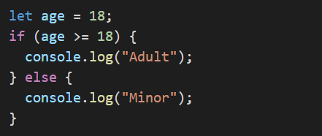
Conditionals
Helps you make decisions in code.
Uses if, else if, and else.
Example:
Notes:
"Conditionals let your program take different paths. It’s like a fork in the road: if the condition is true, one block runs; if not, it goes to the next. Great for building logic into your applications."

Slide 11
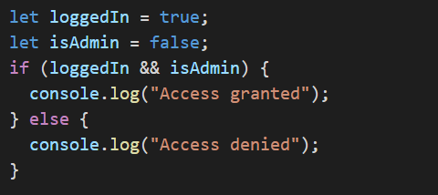
Conditionals Continued
Combine multiple conditions:
&& means 'AND’
|| means 'OR’
Example:
Notes:
"Sometimes one condition isn’t enough. You can combine them using logical operators. For example, both 'loggedIn' AND 'isAdmin' must be true to grant access."

Slide 12
Iterators
Iterators repeat actions.
Commonly used in loops.
Types:
For
While
Do While
Notes:
"Iterators help us perform actions multiple times. For example, printing numbers in a loop using for. It saves time and simplifies repetitive tasks."

Slide 13
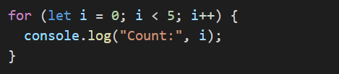
For Loop
Used when the number of iterations is known
Example:
Notes:
"For loops are perfect when you know how many times to repeat. You set a starting point, condition, and increment. It’s clear and concise."

Slide 14
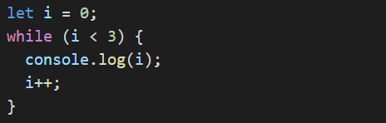
While Loop
Repeats as long as condition is true
Useful when you don’t know how many times to loop
Example:
Notes:
"A while loop keeps going while the condition is true. Be sure to update your variable, or you could create an infinite loop."

Slide 15
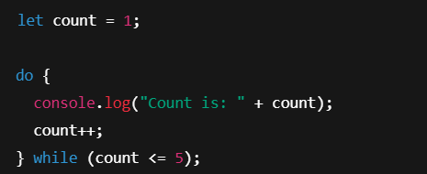
Do While
The do...while loop guarantees one execution, even if the condition is false initially.
Example:

Slide 16
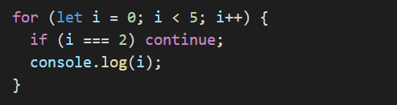
Loop Control
break: exit the loop early
continue: skip current iteration
Example:
Notes:
"Loop control statements help you fine-tune behavior. Use break to exit early and continue to skip an iteration. Useful in filtering or finding specific data."

Slide 17

Arrays and Hashes (Objects)
Arrays: List of items
Objects (similar to hashes): Key-value pairs
Examples:
Notes:
"Arrays store a list of items, like a fruit basket. Objects store data with labels—like name and age. These are essential structures in JavaScript for organizing data."

Slide 18
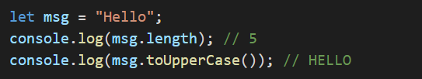
Strings
Strings are sequences of characters.
Can use properties and methods:
.length: returns string length
.toUpperCase(): converts to uppercase
Example:
Notes:
"Strings are used for text. JavaScript offers useful methods like checking length, converting to uppercase, and much more."

Slide 19
Thank You

